Slide 1
Ruth –
A Virtuous Woman
Ruth 1:1-5

Slide 2
Elimelech Takes His Family To Moab
Reasons not to go to Moab.
  Incestuous origin between Lot and his daughter. Genesis 19:30-38
  King of Moab hired Balaam to curse Israel.
  Numbers 22-24
  Recent oppression by Eglon, king of Moab.
  Judges 3:15-30 (Killed by Ehud)
  Moabite culture and god, Chemosh.
  cf. 2 Kings 3:27
Yet, there was rain in Moab. cf. Ruth 1:1

Slide 3
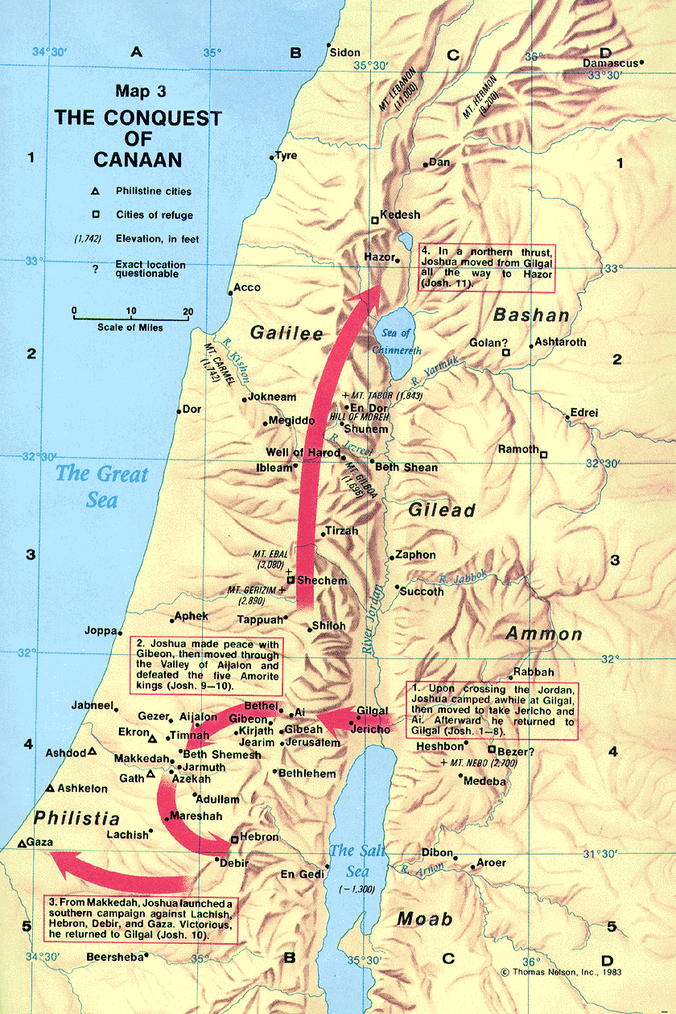
Bethlehem
30 – 60 miles

Slide 4
Ruth Was A Faithful Follower Of God
Words of commitment to Naomi. Ruth 1:16-17
16 “And Ruth said, Entreat me not to leave thee, and to return from following after thee, for whither thou goest, I will go; and where thou lodgest, I will lodge; thy people shall be my people, and thy God my God;
17 where thou diest, will I die, and there will I be buried: Jehovah do so to me, and more also, if aught but death part thee and me.”

Slide 5
Ruth Was Loyal To Naomi
Ruth had opportunity to return to Moab.
1:8-14
Level of Ruth’s commitment to Naomi. 1:16-18; cf. 4:15, “… for thy daughter-in-law, who loveth thee, who is better to thee than seven sons …”

Slide 6
Loyalty Is Important
Loyal to God and His word. Joshua 24:15-21; Judges 2:10; cf. Deuteronomy 6:4-12
Loyal to our spouses. Genesis 2:24; Matthew 19:3-9
Loyal to our children. Ephesians 6:4; Exodus 12; Joshua 4
Loyal to our parents. Ephesians 6:1; 1 Timothy 5:4, 8
Loyal to our brethren. Romans 12:9-10;
Hebrews 13:5; 10:32-35

Slide 7
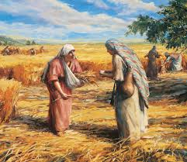
Ruth Was A Hard Worker
Ruth gleaned in the fields all day.
2:1-7, 14-15, 17, 23

Slide 8
Hard Work Is Important
Ephesians 4:28 – Work to help others.
(cf. 2 Thessalonians 3:10)
Ephesians 6:5-9 – Day’s work for a day’s pay.
Ecclesiastes 9:10, “Whatsoever thy hand findeth to do, do (it) with thy might; for there is no work, nor device, nor knowledge, nor wisdom, in Sheol, whither thou goest.”
Lamentations 3:27, “It is good for a man that he bear the yoke in his youth.”

Slide 9
Ruth Had A Good Reputation
Ruth was faithful to God. 1:16
She was loyal to Naomi. 1:16-17; 4:15
She was a hard worker. Chapter 2
Good reputation:
  Left everything to be with Naomi. 2:11
  Everyone knows her to be a worthy woman. 3:11; cf. Proverbs 31

Slide 10
A Good Reputation Is Important
Proverbs 22:1, “A (good) name is rather to be chosen than great riches, (And) loving favor rather than silver and gold.”
Ecclesiastes 7:1, “A (good) name is better than precious oil; and the day of death, than the day of one’s birth.”
cf. Matthew 5:13-16; Philippians 2:12-16; Ephesians 5:1-12

Slide 11
The Rewards Of Ruth’s Character
Boaz cares for Ruth.
  Kinsman who favors Ruth. 2:8, 15
  Gave her six measures of grain. 3:17
Ruth requests redemption from Boaz. 3:1-18
  Buy back inheritance. Note 3:9; 4:3ff
  Kinsman nearer than Boaz. 4:1-6
Ruth receives redemption from Boaz. 4:7-12
Ruth becomes wife to Boaz. 4:13

Slide 12
The Rewards Of Ruth’s Character
Ruth has a child – Obed. Ruth 4:17
“And the women her neighbors gave it a name, saying, There is a son born to Naomi; and they called his name Obed: he is the father of Jesse, the father of David. Now these are the generations of Perez: Perez begat Hezron, and Hezron begat Ram, and Ram begat Amminadab, and Amminadab begat Nahshon, and Nahshon begat Salmon, and Salmon begat Boaz, and Boaz begat Obed, and Obed begat Jesse, and Jesse begat David.”

Slide 13
The Rewards Of Ruth’s Character
Ruth has a child – Obed. Ruth 4:17
(worshiper)
The name Obed occurs only in Ruth 4:17 and in the four genealogies (Ruth 4:21-22; 1 Chronicles 2:12; Matthew 1:5; Luke 3:32).

Slide 14
Ruth Was A Virtuous Woman Because …
She was faithful to God.
She was loyal to Naomi.
She was willing to work hard.
She maintained a good reputation.

